Slide 1
UML

Slide 2
Ex. SatWatch, a watch that resets itself without user intervention
Functional requirements for SatWatch
SatWatch is a wrist watch that displays the time based on its current location. SatWatch uses GPS satellites (Global Positioning System) to determine its location and intemal data structures to convert this location into a time zone.
The information stored in the watch and its accuracy measuring time (one hundredth of second uncertainty over five years) is such that the watch owner never needs to reset the time. SatWatch adjusts the time and date displayed as the watch owner crosses time zones and political boundaries (e.g., standard time vs. daylight savings time). For this reason, SatWatch has no buttons or controls available to the user.
SatWatch has a two-line display showing, on the top line, the time (hour, minute, second, time zone) and, on the bottom line, the date (day of the week, day, month, year). The display technology used is such that the watch owner can see the time and date even under poor light conditions.
When a new country or state institutes different rules for daylight savings time, the watch owner may upgrade the software of the watch using the WebifyWatch seria1 device (provided when the watch is purchased) and a persona1 computer connected to the Intemet. SatWatch complies with the physical, electrical, and software interfaces defined by WebifyWatch API 2.0.
The above functional requirements focus only on the possible interactions between SatWatch and its external world( i.e the watch owner, GPS and webifyWatch). The above description does not focus on any implementation details ( e.g the processor, language, display technology).

Slide 3
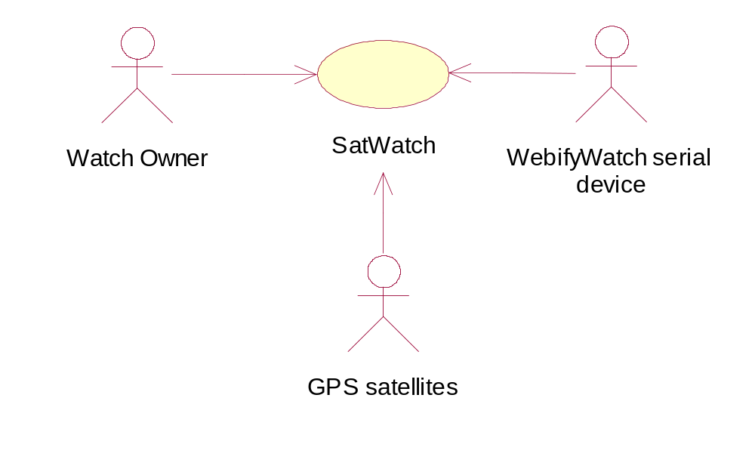
Identifying actors
Actors represent external entities that interact with the system
An actor can be an human or an external system
Actors in the SatWatch example:
  Watch owner
  GPS satellites
  WebifyWatch serial device

Slide 4
Scenario Example: Warehouse on Fire
Bob, driving down main street in his patrol car notices smoke coming out of a warehouse. His partner, Alice, reports the emergency from her car.
Alice enters the address of the building, a brief description of its location (i.e., north west corner), and an emergency level. In addition to a fire unit, she requests several paramedic units on the scene given that area appear to be relatively busy. She confirms her input and waits for an acknowledgment.
John, the Dispatcher, is alerted to the emergency by a beep of his workstation. He reviews the information submitted by Alice and acknowledges the report. He allocates a fire unit and two paramedic units to the Incident site and sends their estimated time of arrival (ETA) to Alice.
Alice receives the acknowledgment and the ETA.
Notes:
Scenario Example: Warehouse on Fire
Bob, driving down main street in his patrol car notices smoke coming out of a warehouse. His partner, Alice, reports the emergency from her car.
Alice enters the address of the building, a brief description of its location (i.e., north west corner), and an emergency level. In addition to a fire unit, she requests several paramedic units on the scene given that area appear to be relatively busy. She confirms her input and waits for an acknowledgment.
John, the Dispatcher, is alerted to the emergency by a beep of his workstation. He reviews the information submitted by Alice and acknowledges the report. He allocates a fire unit and two paramedic units to the Incident site and sends their estimated time of arrival (ETA) to Alice.
Alice receives the acknowledgment and the ETA.

Slide 5
Identifying Use Cases
A use case is a flow of events in the system, including interaction with actors
It is initiated by an actor
Each use case has a name
Each use case has a termination condition
Graphical Notation: An oval with the name of the use case
ReportEmergency
Use Case Model: The set of all use cases specifying the complete functionality of the system
Notes:
Use Cases
A use case is a flow of events in the system, including interaction with actors
It is initiated by an actor
Each use case has a name
Each use case has a termination condition
Graphical Notation: An oval with the name of the use case
Use Case Model: The set of all use cases specifying the complete functionality of the system

Slide 6
Example: Use Case Model for Incident Management
FieldOf
icer
Dispatcher
f
OpenIncident
ReportEmergency
AllocateResources
Notes:
Example: Use Case Model for Incident Management

Slide 7
Heuristics: How to find use cases?
Select a narrow vertical slice of the system (i.e. one scenario)
  Discuss it in detail with the user to understand the user’s preferred style of interaction
Select a horizontal slice (i.e. many scenarios) to define the scope of the system.
  Discuss the scope with the user
Use illustrative prototypes (mock-ups) as visual support
Find out what the user does
  Task observation (Good)
  Questionnaires (Bad)
Notes:
Heuristics: How to find use cases?
Select a narrow vertical slice of the system (i.e. one scenario)
Discuss it in detail with the user to understand the user’s preferred style of interaction
Select a horizontal slice (i.e. many scenarios) to define the scope of the system.
Discuss the scope with the user
Use illustrative prototypes (mock-ups) as visual support
Find out what the user does
Task observation (Good)
Questionnaires (Bad)

Slide 8
How to Specify a Use Case (Summary)
Name of Use Case
Actors
  Description of Actors involved in use case
Entry condition
  “This use case starts when…”
Flow of Events
  Free form, informal natural language
Exit condition
  “This use cases terminates when…”
Exceptions
  Describe what happens if things go wrong
Special Requirements
  Nonfunctional Requirements, Constraints
Notes:
Name of Use Case
Actors
Description of Actors involved in use case)
Entry condition
“This use case starts when…”
Flow of Events
Free form, informal natural language
Exit condition
“This use cases terminates when…”
Exceptions
Describe what happens if things go wrong
Special Requirements
Nonfunctional Requirements, Constraints

Slide 9
Use Case Example: ReportEmergency
Use case name: ReportEmergency
Participating Actors:
  Initiated by Field Officer (Bob and Alice in the Scenario)
  Communicates with Dispatcher (John in the Scenario)
Entry Conditions:
  The FieldOfficer is logged into FRIEND
Exit Conditions:
  The FieldOfficer has received an acknowledgement and the selected response from the Dispatcher, OR
  The FieldOfficer has received an explanation indicating why the transaction could not be processed.
Flow of Events: on next slide.
Special Requirements:
  The FieldOfficer’s report is acknowledged within 30 seconds. The selected response arrives no later than 30 seconds after it is sent by the Dispatcher.
Notes:
Use Case Example: ReportEmergency
Use case name: ReportEmergency
Participating Actors:
Field Officer (Bob and Alice in the Scenario)
Dispatcher (John in the Scenario)
Exceptions:
The FieldOfficer is notified immediately if the connection between her terminal and the centre is lost.
The Dispatcher is notified immediately if the connection between any logged in FieldOfficer and the centre is lost.
Flow of Events: on next slide.
Special Requirements:
The FieldOfficer’s report is acknowledged within 30 seconds. The selected response arrives no later than 30 seconds after it is sent by the Dispatcher.

Slide 10
Use Case Example: Report Emergency Flow of Events
The FieldOfficer activates the “Report Emergency” function of her terminal.
FRIEND responds by presenting a form to the officer.
The FieldOfficer fills the form, by selecting the emergency level, type, location, and brief description of the situation. The FieldOfficer also describes possible responses to the emergency situation. Once the form is completed, the FieldOfficer submits the form, at which point, the Dispatcher is notified.
The Dispatcher reviews the submitted information and creates an Incident in the database by invoking the OpenIncident use case. The Dispatcher selects a response and acknowledges the emergency report.
The FieldOfficer receives the acknowledgment and the selected response.
Notes:
Use Case Example: Report Emergency Flow of Events
1. The FieldOfficer activates the “Report Emergency” function of her terminal.
2. FRIEND responds by presenting a form to the officer.
3.The FieldOfficer fills the form, by selecting the emergency level, type, location, and brief description of the situation. The FieldOfficer also describes possible responses to the emergency situation. Once the form is completed, the FieldOfficer submits the form, at which point, the Dispatcher is notified.
4.The Dispatcher reviews the submitted information and creates an Incident in the database by invoking the OpenIncident use case. The Dispatcher selects a response and acknowledges the emergency report.
5.The FieldOfficer receives the acknowledgment and the selected response.

Slide 11
Order of steps when formulating use cases
First step: name the use case
  Use case name: ReportEmergency
Second step: Find the actors
  Generalize the concrete names (“Bob”) to participating actors (“Field officer”)
  Participating Actors:
    Field Officer (Bob and Alice in the Scenario)
    Dispatcher (John in the Scenario)
Third step: Then concentrate on the flow of events
  Use informal natural language
Notes:
Order of steps when formulating use cases
First step: name the use case
Use case name: ReportEmergency
Second step: Find the actors
Generalize the concrete names (“Bob”) to participating actors (“Field officer”)
Participating Actors:
Field Officer (Bob and Alice in the Scenario)
Dispatcher (John in the Scenario)
Third step: Then concentrate on the flow of events
Use informal natural language

Slide 12
Communication relationships between actors and use cases
Communication relationships between actors and use cases represent the flow of information during the use case.
It shows which actor initiates the use case.
The relationships between actors and use cases are identified when use cases are identified.
By documenting initiation and communication relationships among actors and use cases, we specify access control for the system at a coarse level.
The <<initiate>> stereotype denotes the initiation of the use case by an actor.
The <<participate>> stereotype denotes that an actor ( who did not initiate the use case) communicates with the use case.

Slide 13
Example: Use Case Model for Incident Management
<<initiate>>
<<initiate>>
<<participate>>
Dispatcher
FieldOf
icer
f
OpenIncident
<<initiate>>
ReportEmergency
AllocateResources

Slide 14
2.Use Case Associations
A use case model consists of use cases and use case associations
  A use case association is a relationship between use cases
Important types of use case associations: Include, Extend, Generalization
Include
  A use case uses another use case (functional decomposition)
Extend
  A use case extends another use case (alternatives)
Generalization (and Specialization)
  An abstract use case using inheritance hierarchy
Notes:
Use Case Associations
A use case model consists of use cases and use case associations
A use case association is a relationship between use cases
Important types of use case associations: Include, Extends, Generalization
Include
A use case uses another use case (“functional decomposition”)
Extends
A use case extends another use case
Generalization (and Specialization)
An abstract use case using inheritance hierarchy

Slide 15
<<Include>>: Functional Decomposition
Problem:
  A function in the original problem statement is too complicated to be described as a single use case
Solution:
  Describe the function as a collection of simpler functions. The associated use case is made up of several smaller use cases.
ManageIncident
<<include>>
<<include>>
<<include>>
CreateIncident
HandleIncident
CloseIncident
Notes:
<<Include>>: Functional Decomposition
Problem:
A function in the original problem statement is too complicated to be described as a single use case
Solution:
Describe the function as a collection of simpler functions. The associated use case is made up of several smaller use cases

Slide 16
<<Include>>: Reuse of Existing Functionality
Problem:
  There are already existing functions. How can we reuse them?
Solution:
  The include association from a use case A to a use case B indicates that an instance of the use case A performs all the behavior described in the use case B (“A delegates to B”)
Example:
  Use case “ViewMap” describing behaviour common to use cases “OpenIncident” and “AllocateResources” already exists; so factor it out.
<<include>>
OpenIncident
Base Use
Case
ViewMap
<<include>>
Supplier
Use Case
AllocateResources
Note: The base use case is incomplete on its own. It is always used along with its supplier use case.
Notes:
<<Include>>: Reuse of Existing Functionality
Problem:
There are already existing functions. How can we reuse them?
Solution:
The include association from a use case A to a use case B indicates that an instance of the use case A performs all the behavior described in the use case B (“A delegates to B”)
Example:
Use case “ViewMap” describing behaviorused by the use cases “OpenIncident” and AllocateResources already exists, so factor it out.
Note: The base case cannot exist alone. It is always called with the supplier use case.

Slide 17
<Extend>> Association for Use Cases
Problem:
  The functionality in the original problem statement needs to be extended (to deal with exceptions or alternatives).
Solution:
  An extend association from a use case A to a use case B indicates that use case B is an extension of use case A.
Example:
  The use case “ReportEmergency” is complete by itself , but can be extended by the use case “Help” for a specific scenario in which the user requires help
Help
FieldOfficer
f
<<extend>>
ReportEmergency
Note: Base use case is complete on its own. Extend association starts at the extending use case and points to the extended use case.
Notes:
<Extend>> Association for Use Cases
Problem:
The functionality in the original problem statement needs to be extended (to deal with exceptions or alternatives).
Solution:
An extend association from a use case A to a use case B indicates that use case B is an extension of use case A.
Example:
The use case “ReportEmergency” is complete by itself , but can be extended by the use case “Help” for a specific scenario in which the user requires help
Note: The base use case can be executed without the use case extension in extend associations.

Slide 18
Generalization association in use cases
Problem:
  Common behavior among many use cases – redundant to update
Solution:
  The generalization association among use cases abstracts out common behavior. The child use cases inherit the behavior and meaning of the parent use case.
Example:
  Consider the use case “ValidateUser”, responsible for verifying the identity of the user. The customer might require two realizations: “CheckPassword” and “CheckFingerprint”
CheckPassword
Parent
Case
ValidateUser
Child
Use Case
CheckFingerprint
Notes:
Problem:
You have common behavior among use cases and want to factor this out.
Solution:
The generalization association among use cases factors out common behavior. The child use cases inherit the behavior and meaning of the parent use case and add or override some behavior.
Example:
Consider the use case “ValidateUser”, responsible for verifying the identity of the user. The customer might require two realizations: “CheckPassword” and “CheckFingerprint”

Slide 19
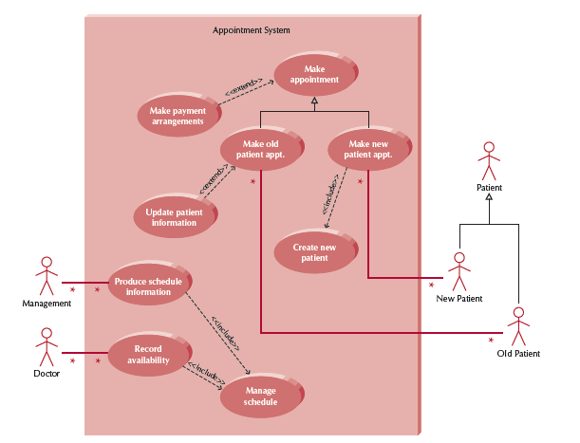

Slide 20
Class and Instance Diagrams
Inspector
Class Diagram
joe:
Inspector
mary:
Inspector
anonymous:
Inspector
Instance Diagram

Slide 21
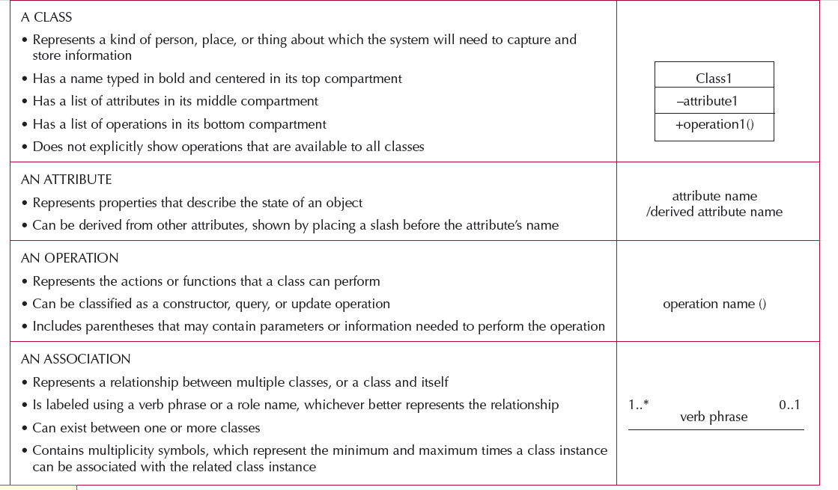


Slide 22
Attributes and Values
Inspector
name:string
age: integer
joe:Inspector
mary: Inspector
name = “Joe”
name = “Mary”
age = 24
age = 18

Slide 23
Links and Associations
Links and associations establish relationships among objects and classes.
Link:
  A connection between two object instances. A link is like a tuple.
  A link is an instance of an association
Association:
  Basically a bidirectional mapping.
  One-to-one, many-to-one, one-to-many,
  An association describes a set of links like a class describes a set of objects.

Slide 24
1-to-1 and 1-to-many Associations
Country
Has-capital
City
name:String
name:String
One-to-one association
StickyNote
Workorder
*
x: Integer
y: Integer
z: Integer
schedule()
One-to-many association

Slide 25
Object Instance Diagram
Example for 1-to-many
:Sticky
:WorkOrder
:Sticky
x,y,z=(-1,0,5)
x,y,z=(1,10,1)
:Sticky
x,y,z=(10,1,2)

Slide 26
Many-to-Many Associations
Mechanics
Plane
*
Work on
*

Slide 27
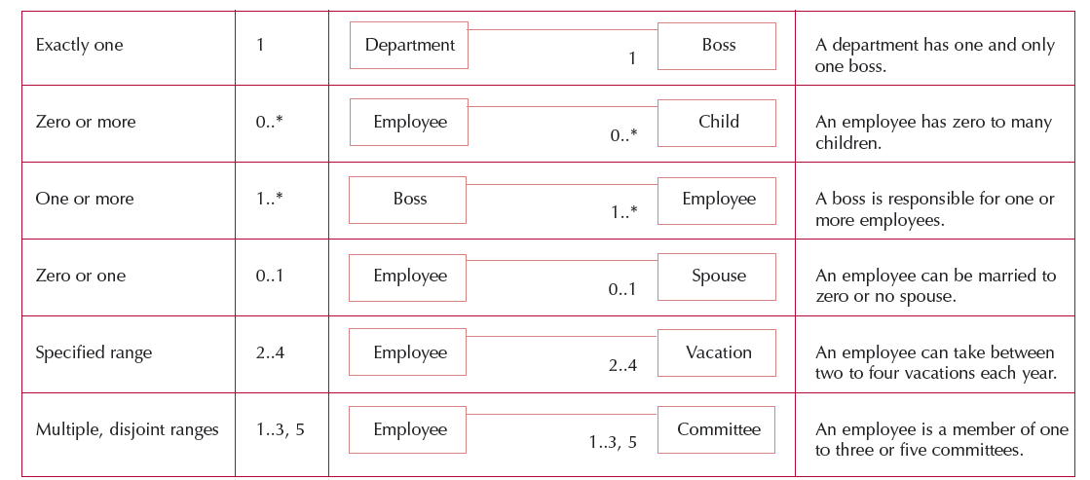
Multiplicity

Slide 28
Do UML associations have direction?
A association between two classes is by default a bi-directional mapping.
    Class A can access class B and class B can access class A
    Both classes play the agent role.
A
B
Name Direction
Name of association
Association Direction
accesses
B
A

Slide 29
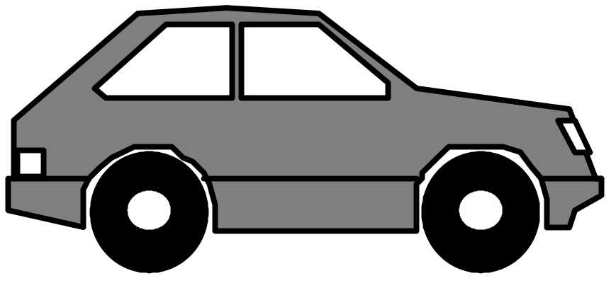
Aggregation
Models "part of" hierarchy
Useful for modeling the breakdown of a product into its component parts (sometimes called bills of materials (BOM) by manufacturers)
UML notation: Like an association but with a small diamond indicating the assembly end of the relationship.

Slide 30
Aggregation
Automobile
Engine
serial number
horsepower
year
volume
manufacturer
model
on
color
off
weight
drive
purchase
Wheel
Brakelight
Door
Battery
diameter
open
amps
number of bolts
volts
on
close
off
charge
discharge

Slide 31
Inheritance
Models "kind of" hierarchy
Powerful notation for sharing similarities among classes while preserving their differences
UML Notation: An arrow with a triangle
Cell
BloodCell
MuscleCell
NerveCell
Red
White
Smooth
Striate
Cortical
Pyramidal

Slide 32
Aggregation vs Inheritance
Both associations describe trees (hierarchies)
  Aggregation tree describes a-part-of relationships (also called and-relationship)
  Inheritance tree describes "kind-of" relationships (also called or-relationship)
Aggregation relates instances (involves two or more different objects)
Inheritance relates classes (a way to structure the description of a single object)

Slide 33
Roles
A role name is the name that uniquely identifies one end of an association.
A role name is written next to the association line near the class that plays the role.
When do you use role names?
  Necessary for associations between two objects of the same class
  Also useful to distinguish between two associations between the same pair of classes
When do you not use role names?
  If there is only a single association between a pair of distinct classes, the names of the classes serve as good role names

Slide 34
Example of Role
Pr
oblem Statement
:
A
person assumes the role of repairer
with respect to another person, who assumes the role of
inspector with respect to the first person.
Person
Person
Creates Workorders
*
Person
inspector
*
Person
Creates Workorders
repairperson

Slide 35
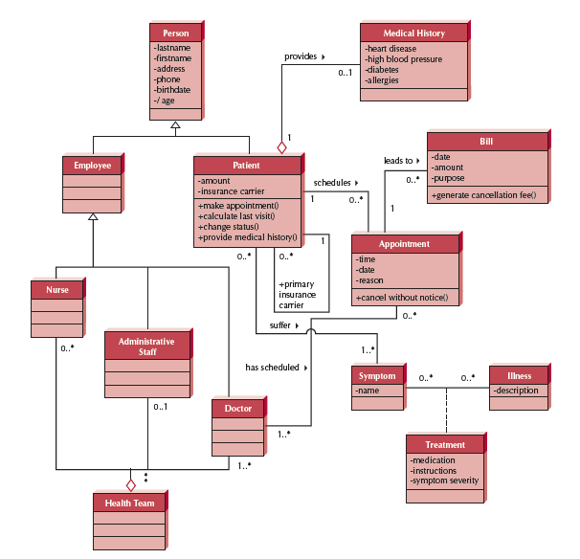

Slide 36
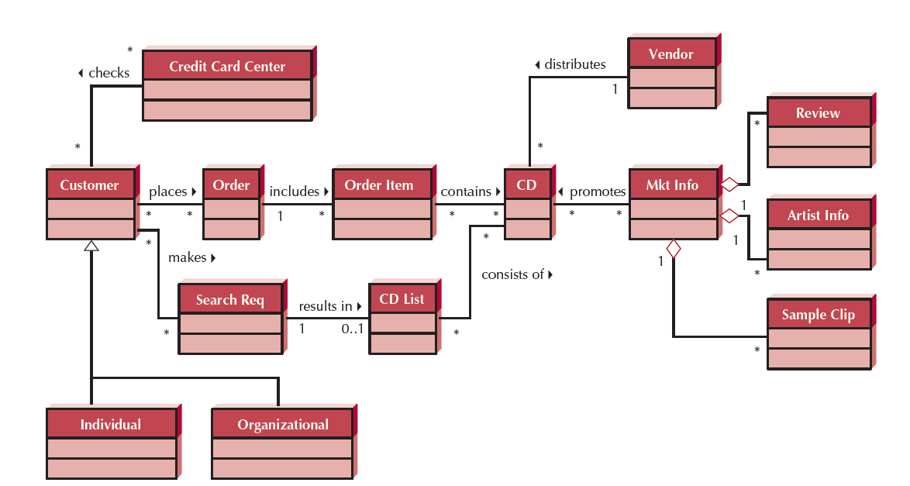

Slide 37
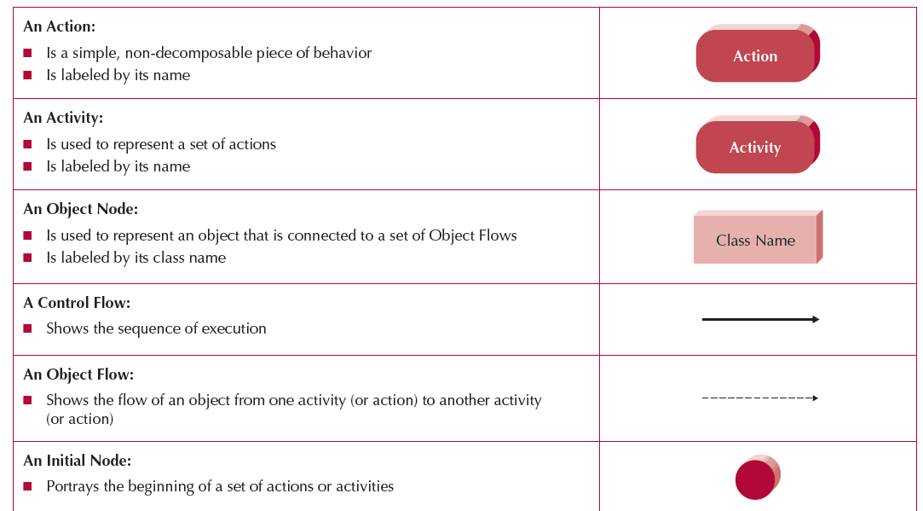
Activity Diagram

Slide 38
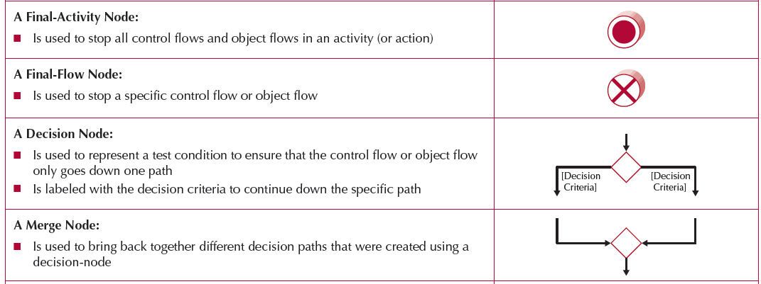
Activity Diagram

Slide 39
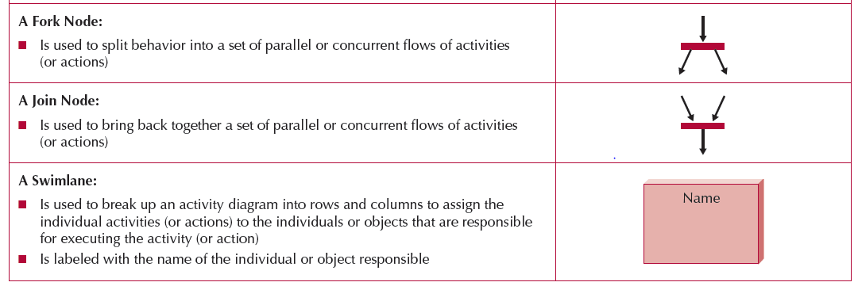
Activity Diagram

Slide 40
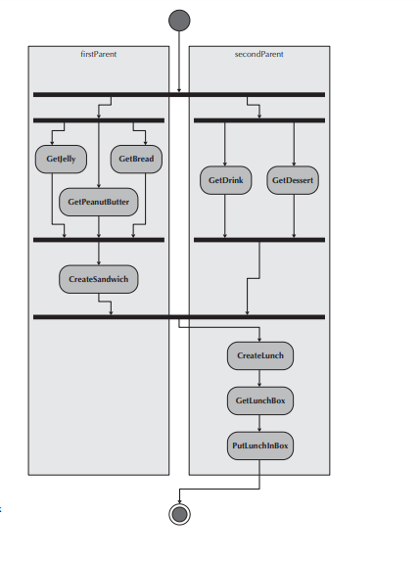

Slide 41
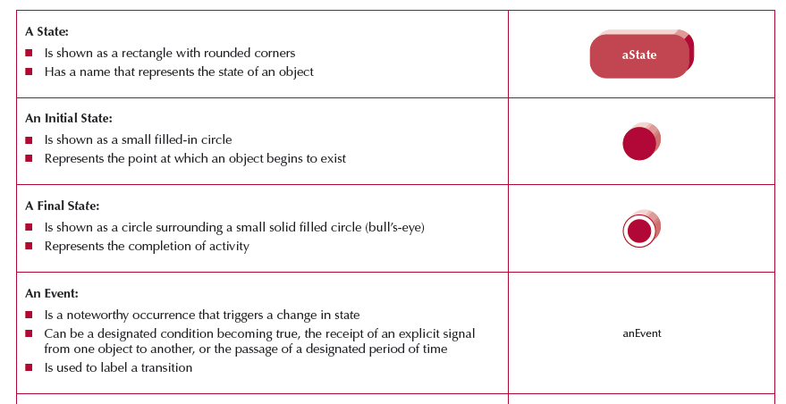
State Machine

Slide 42
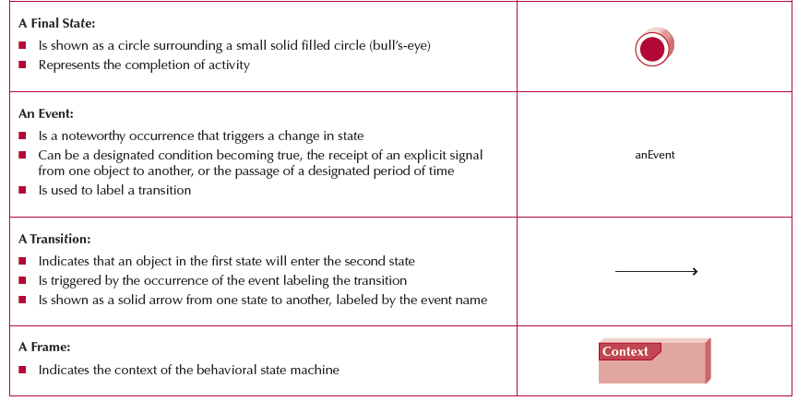
State Machine

Slide 43
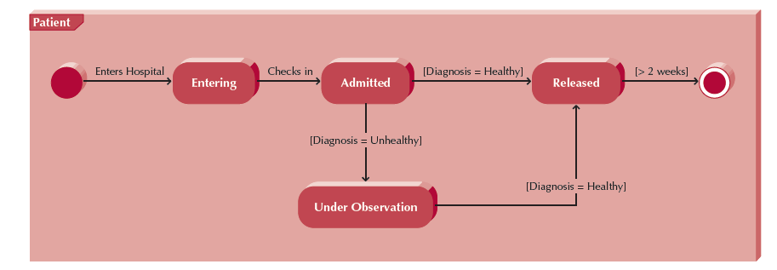
State Machine

Slide 44
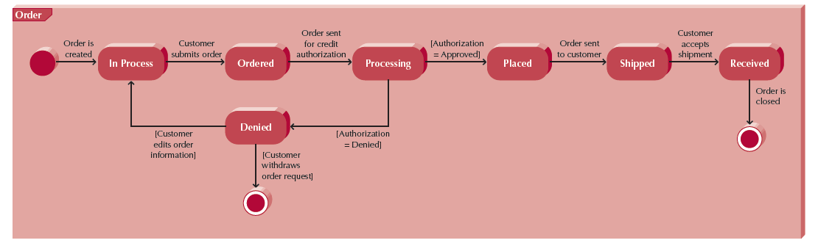
State Machine

Slide 45
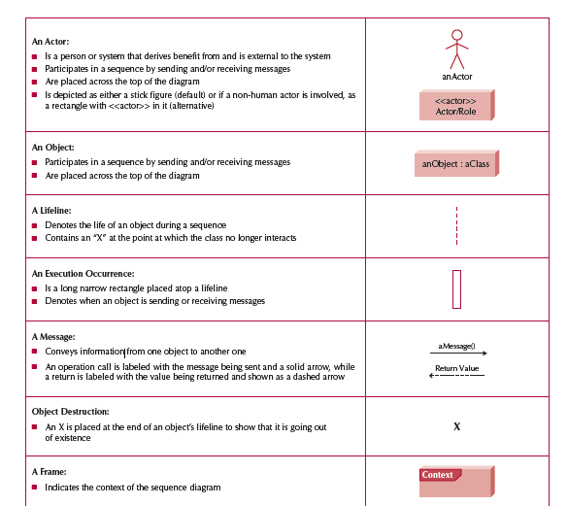
Sequence Diagram

Slide 46
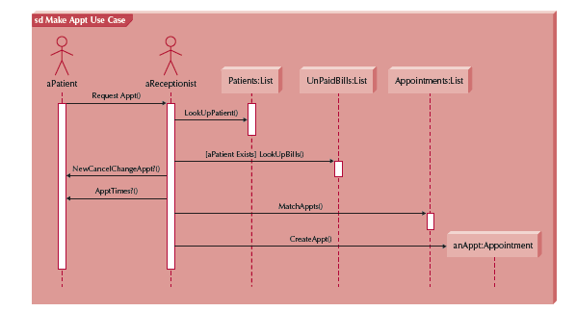
Sequence Diagram

Slide 47
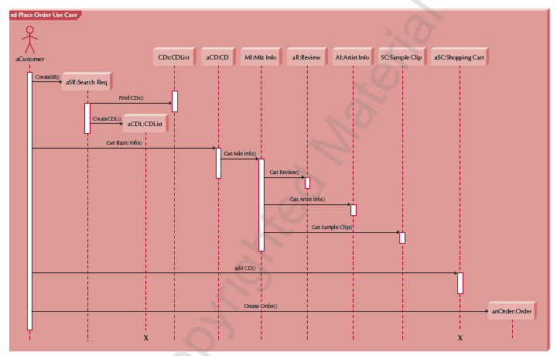
Sequence Diagram

